Slide 1

Update design class diagram

Slide 2
Updating Design Class Diagram
Add classes for the view and data access layers
Update classes with method signatures:
  Constructor and get and set methods are optional
  Use case specific methods are required
Every message in a sequence diagram requires a method in the destination object

Slide 3
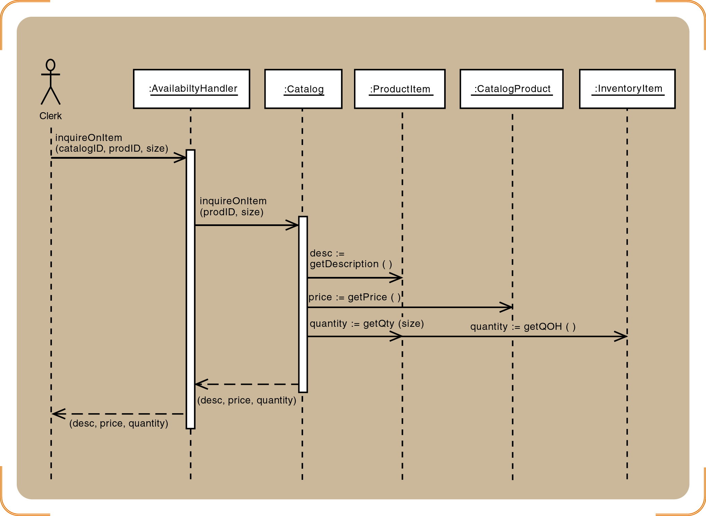
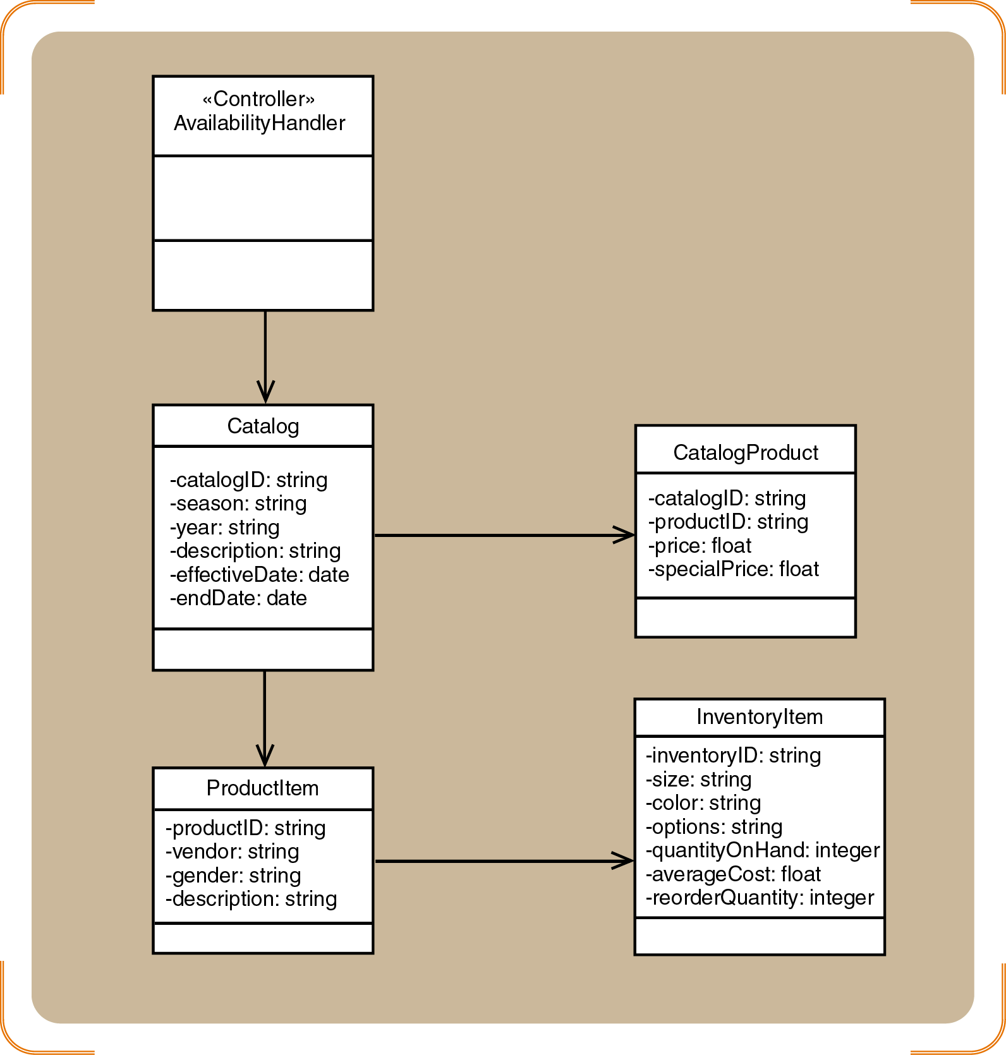

Sequence Diagram vs. Domain Model

Slide 4
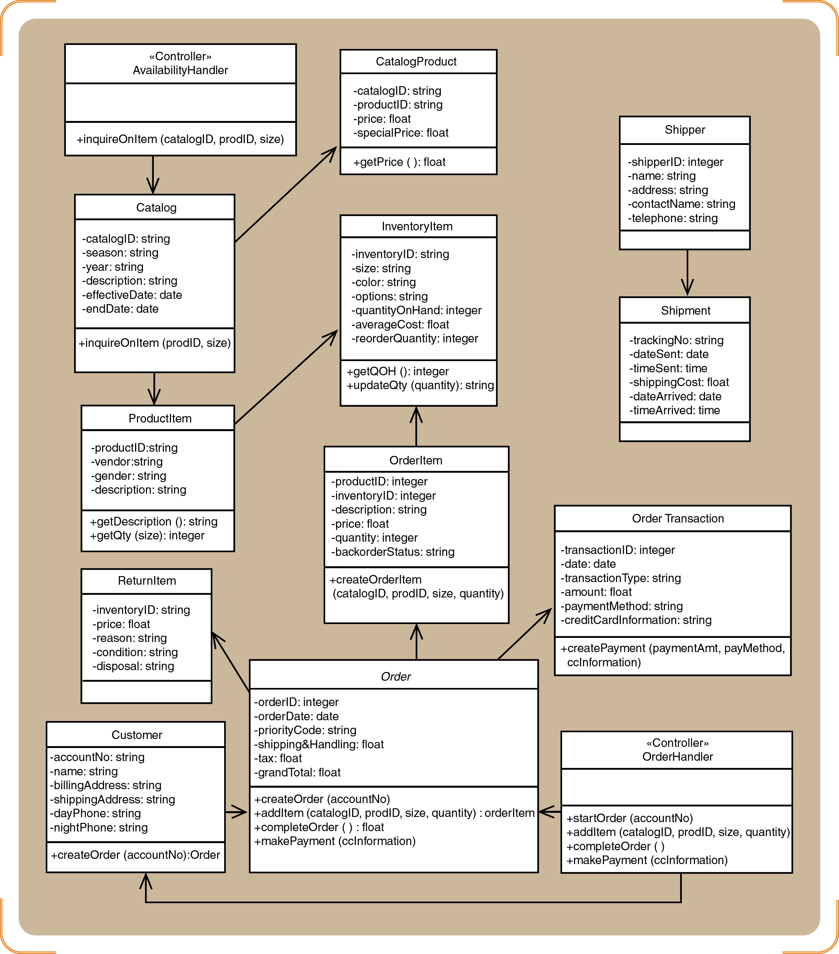
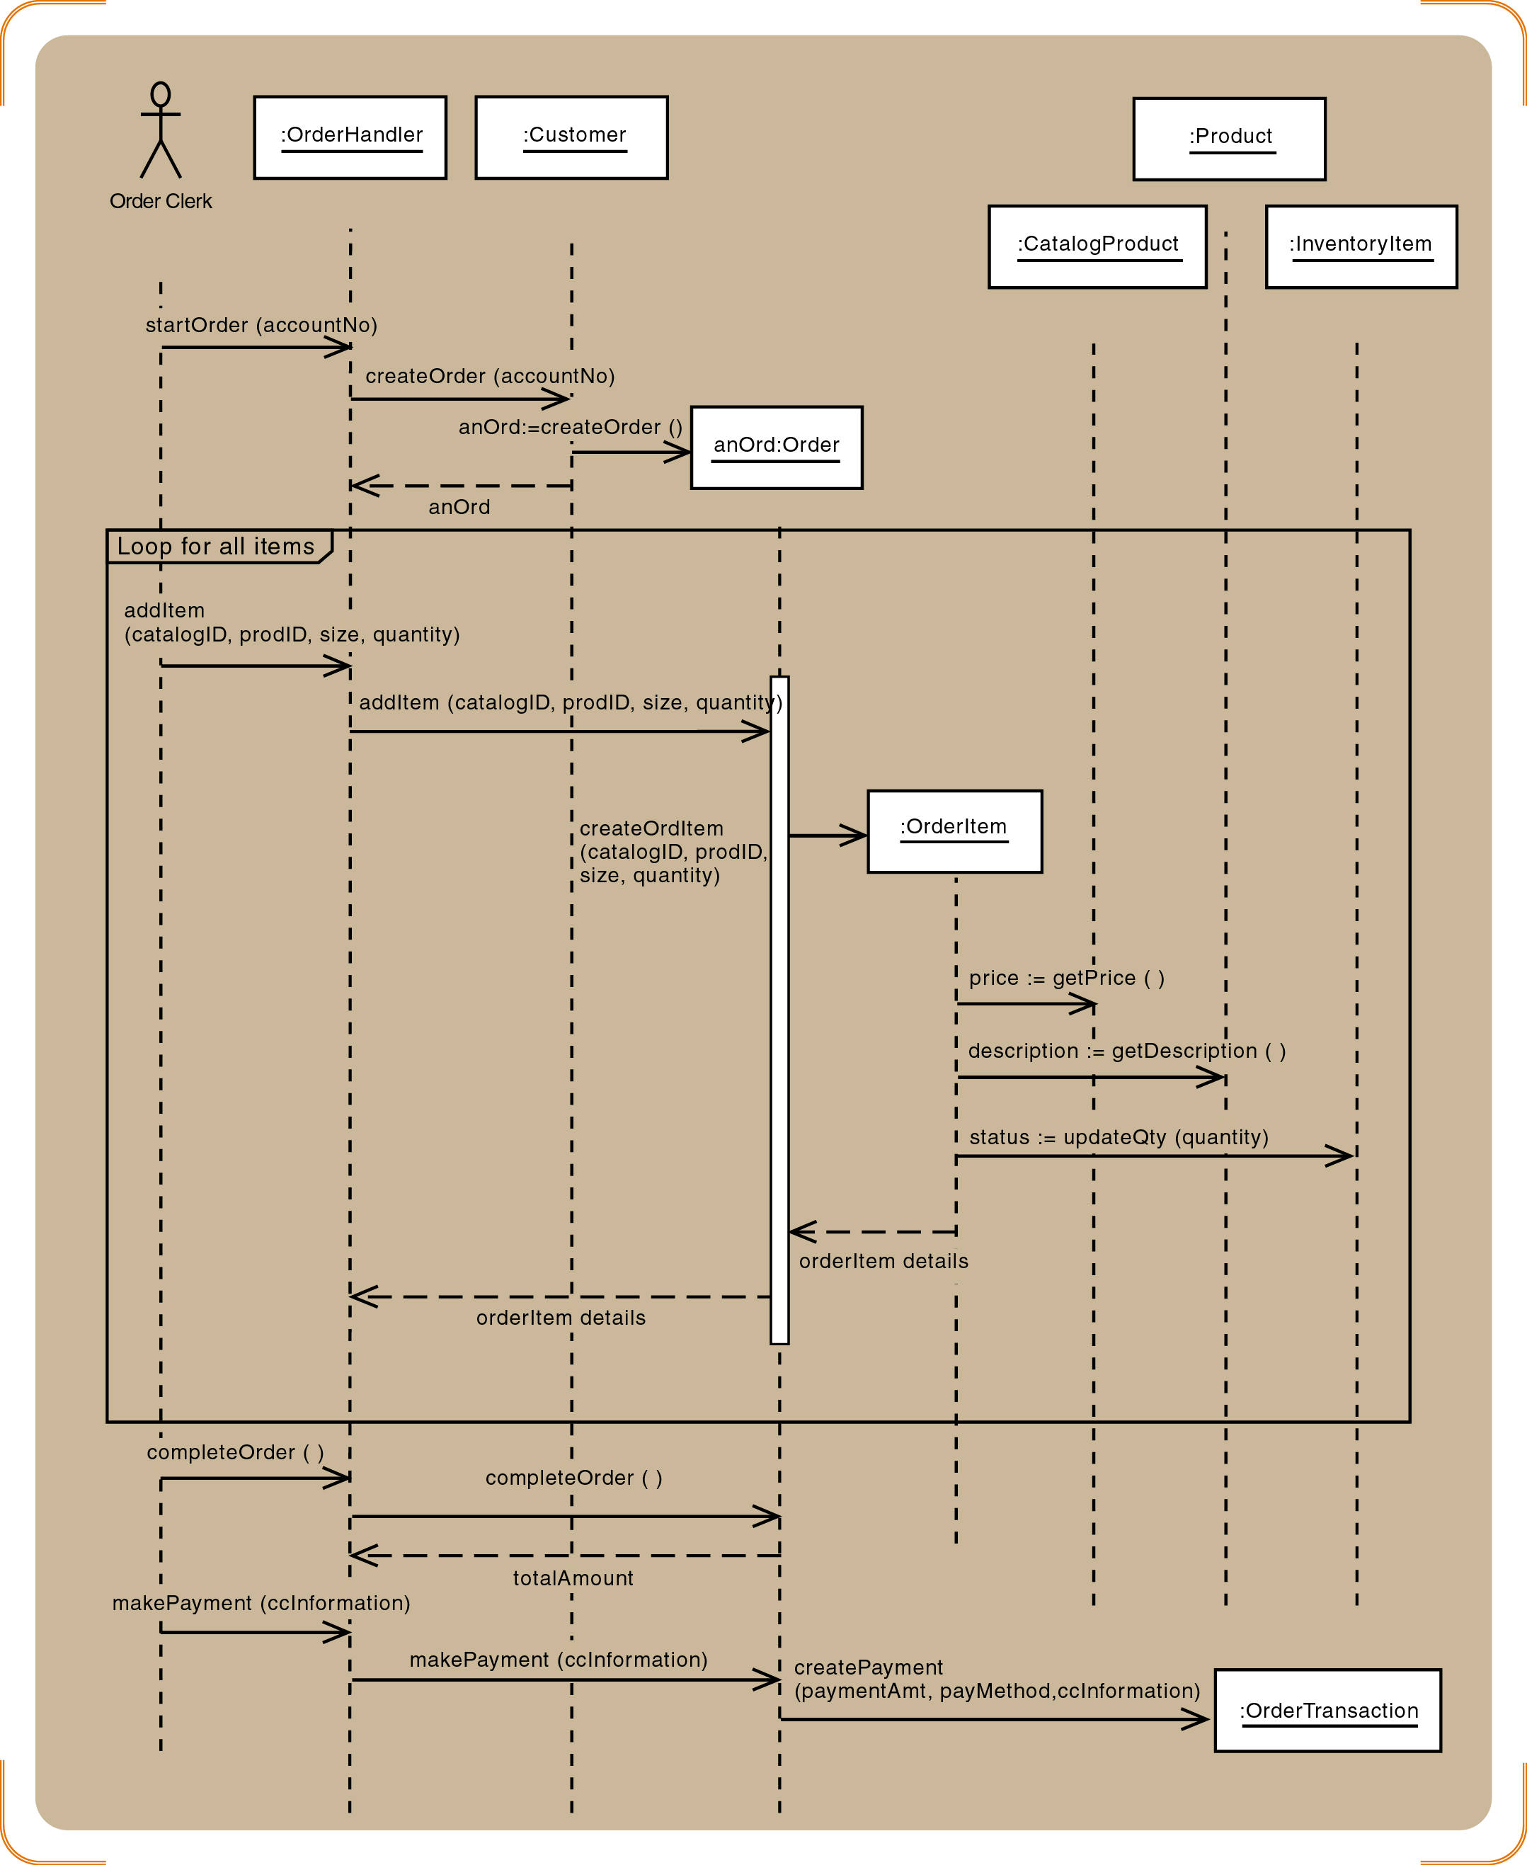
Design Class Diagram vs.
Sequence Diagram
Same input message

Slide 5

Key Points
Object-oriented detailed design is a low level design involves the identification and description of sets of objects that must work together for each use case
Fundamental design principles include encapsulation, object reuse, information hiding, navigation visibility, cohesion, coupling and separation of responsibilities
Models involved in detailed design from analysis stage are class diagram and sequence diagram
Classes with related resonsibilites should be grouped in a package as a subsystem of the system

